Slide 1
Summer Training
“Software Development for Factorial, Gamma and Beta Functions Computation”
Undertaken at- Guided by-
DRDO Jodhpur D.K. Tripathi (Scientist ‘F’ )

Slide 2
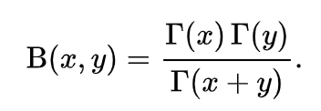
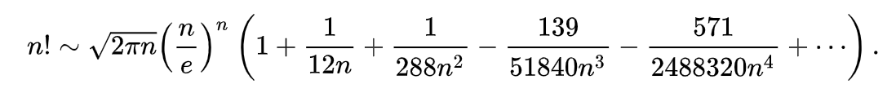
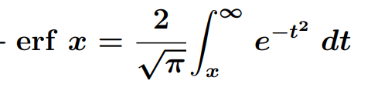
Introduction
Designing algorithms for calculation of mathematical functions for scientific purposes with accuracy upto 7 floating points.
Areas of their use-
Beta distribution where beta function is used to determine average time of completing selected tasks in time management problems
Gamma function is used in gamma distribution which is used to determine time based occurrences, such as life span of an electronic component etc
Error Function is use in dealing with Maxwell-Boltzmann distributions, because the velocities of particles are normally distributed.
Gamma
Beta
Factorial
Error

Slide 3
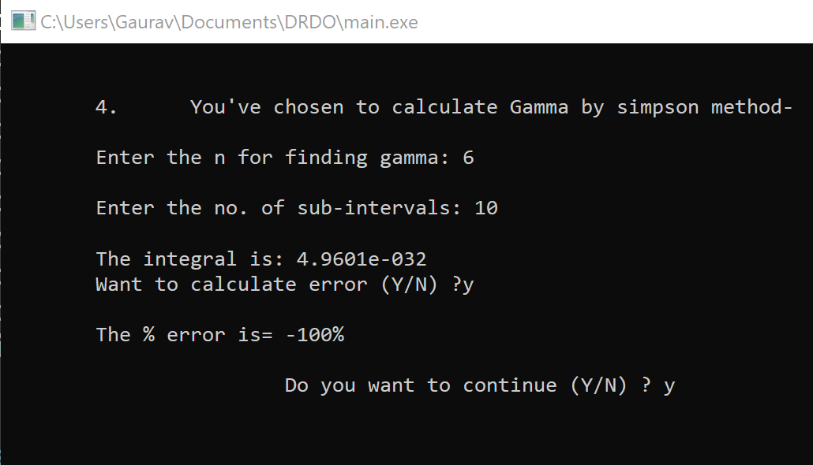
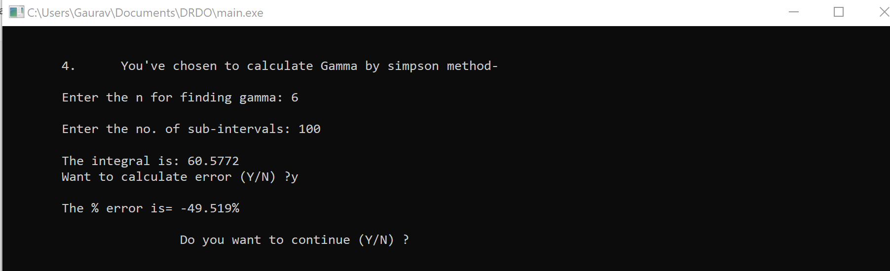
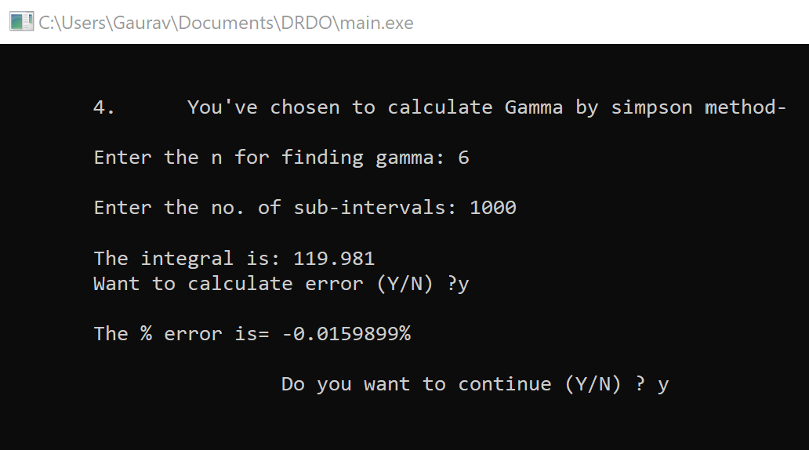
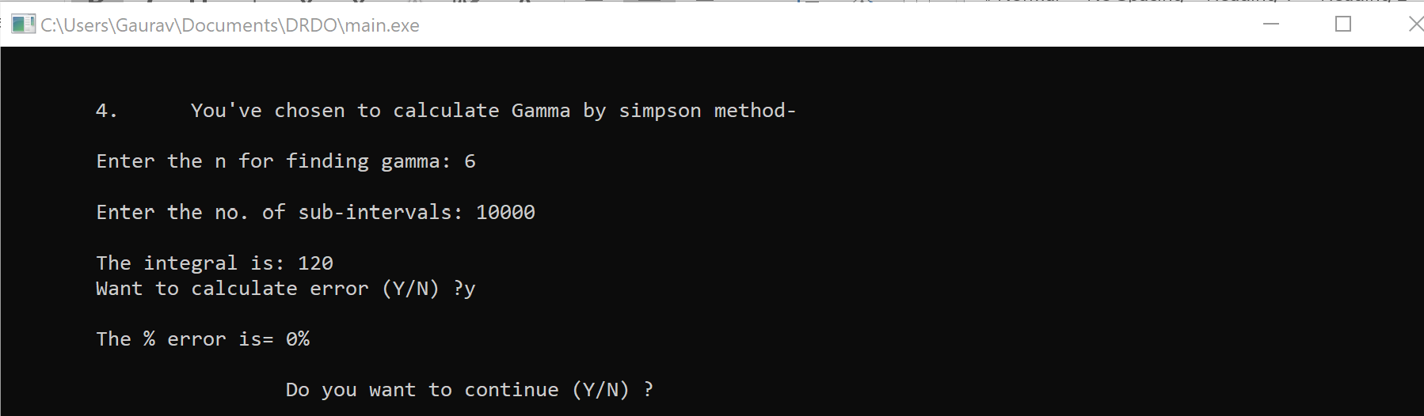
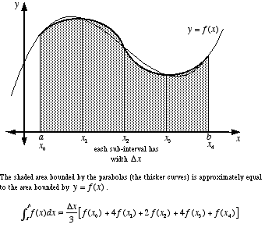
Testing- Code testing revolve around the precision of the output of algorithm and the inputs it can handle in a certain time.
Ex.
As the interval size is increased, there is drastic improvement in accuracy, 0% error is valid for double datatype only, as there will be a bigger datatype used there will be a small chance of error. In such case, the Sub-Intervals should be further increased.
Sub-Intervals | Value | Error %
10 | 4.961*10^-32 | >100
100 | 60.5772 | 49.519
1000 | 119.981 | 0.0159899
10000 | 120 | 0

Slide 4
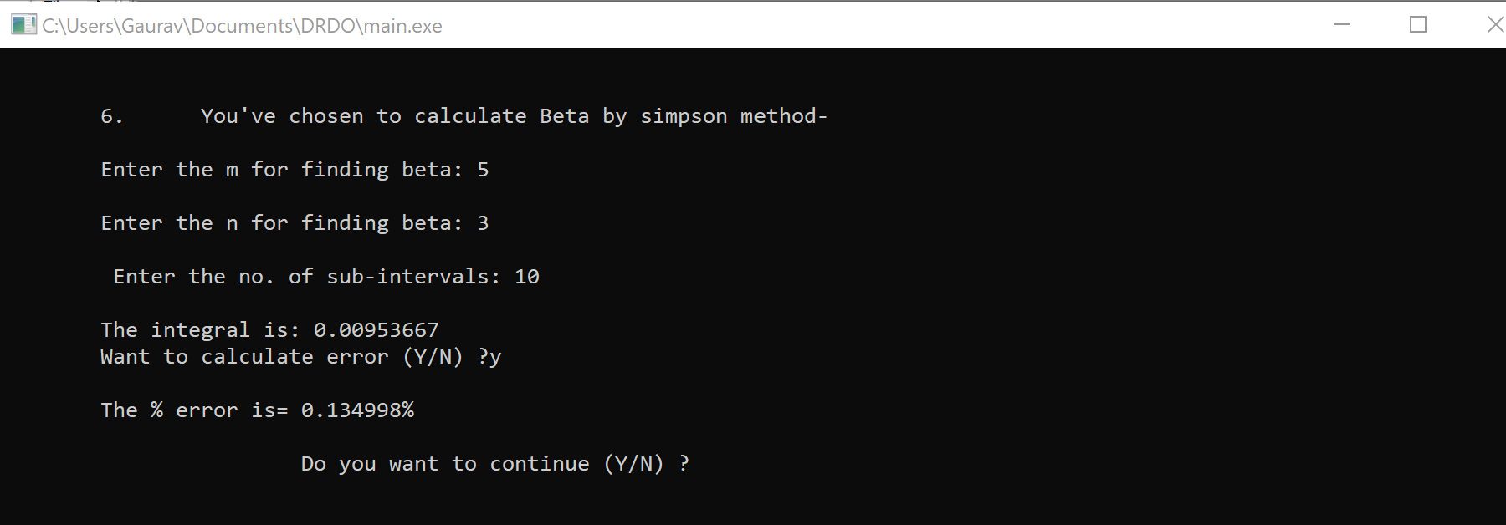
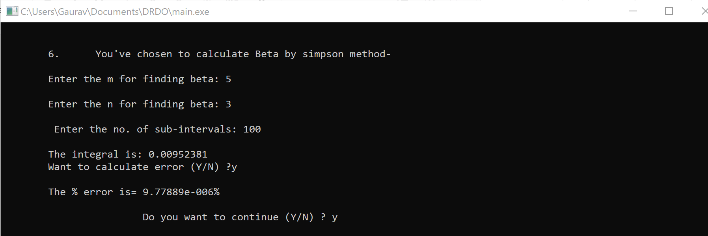
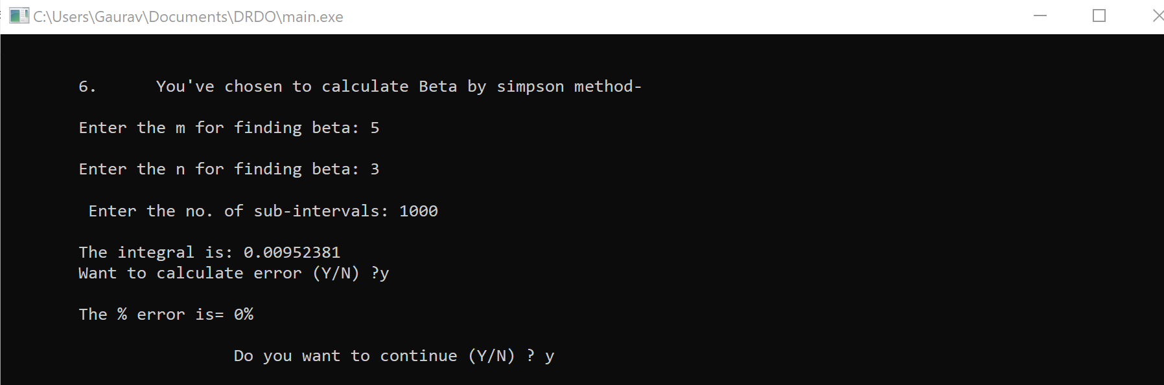
Ex. 2
The error percentage decreases with the increase in sub-intervals, higher the number of intervals the more precise and accurate will be the beta. Here the limitation of datatype plays a major role where the answer is accurate to the eighth decimal place but error is still encountered, in such case, the higher bit datatype is to be used to remove such error.
c
Sub-Intervals | Value |  | Error %
10 | .00953667 |  | .134998
100 | .00952381 |  | 9.7789*10^-6
1000 | .00952381 |  | 0
10000 | .00952381 |  | 0

Slide 5
Software Design and Devlopment
Requirement Analysis- i) Range of input values
ii) Precision of output
iii) Running time of algorithms
System Design- Switch-Menu Program for the implementation of functions.
Implementation- Language used C++

Slide 6
Source Code Listings
The source code can be found at-
https://drive.google.com/open?id=1iRhyAq9bTSimDEBRAbcJxiMpo9sMj4K8
All the testing versions of individual algorithms are here-
https://drive.google.com/open?id=1ku1CrCKv9ptn5jCSZ81hCPbFwQuW4xf7

Slide 7
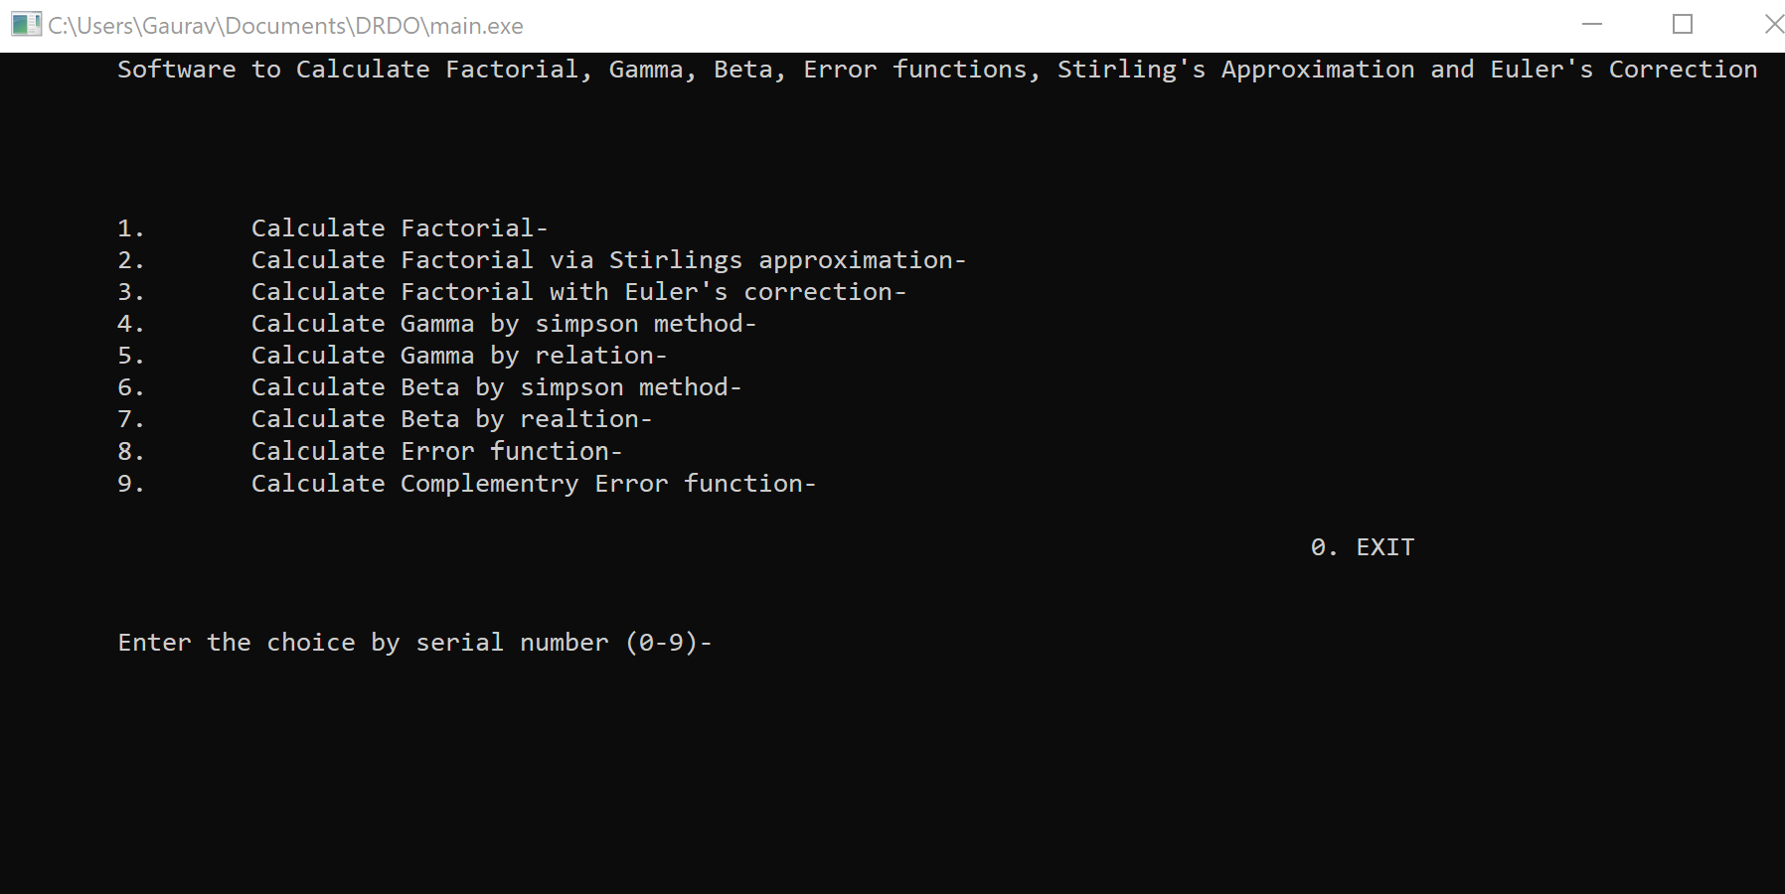
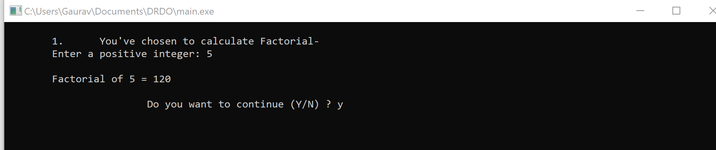
Outputs
Main Menu
Factorial Function

Slide 8
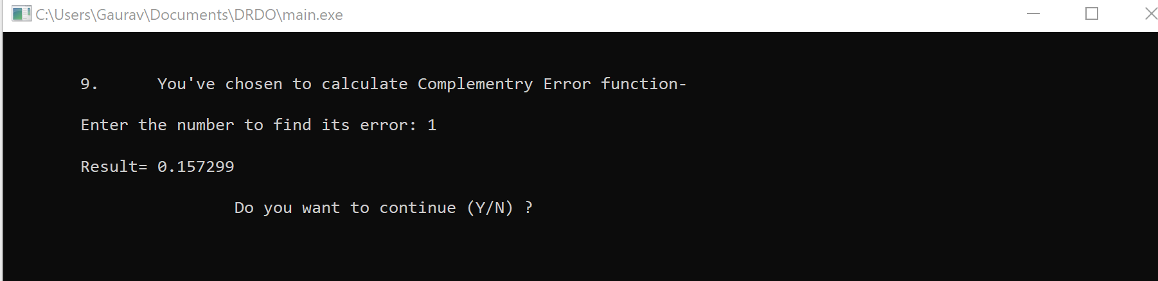
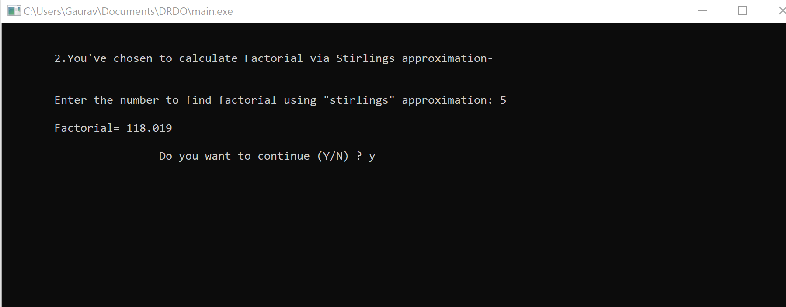
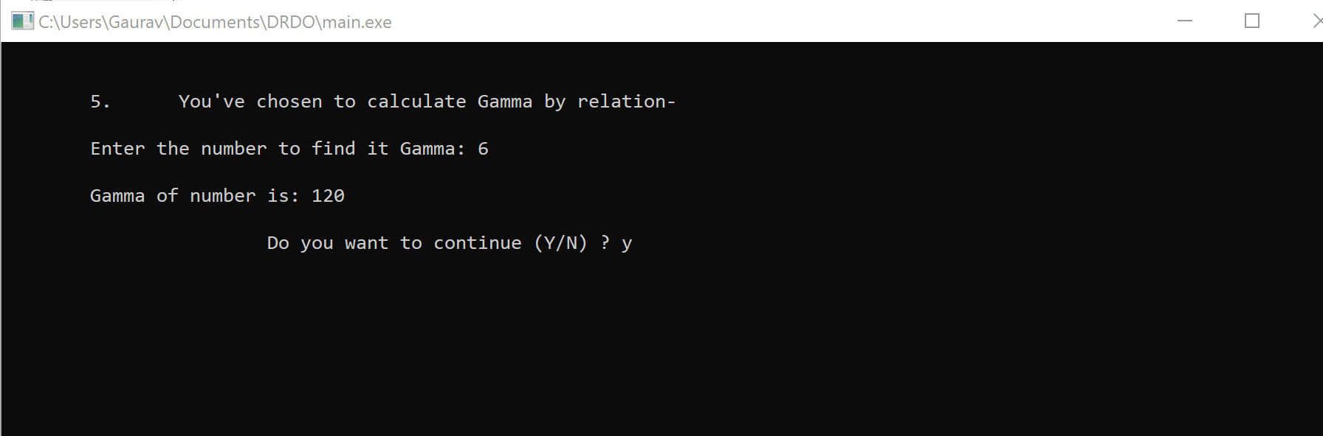
Complementary Error function
Factorial by Stirling’s Approximation
Factorial after Euler’s Correction

Slide 9
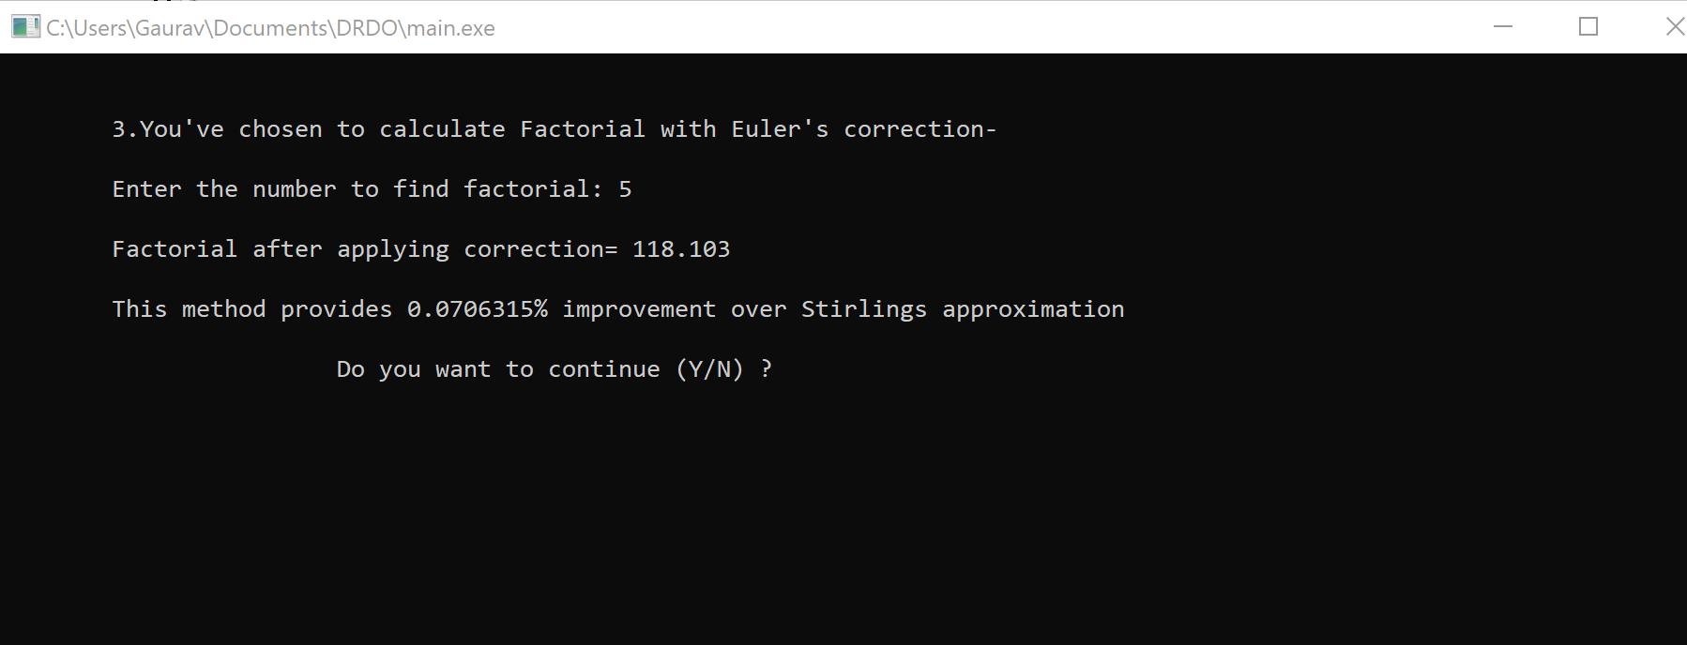
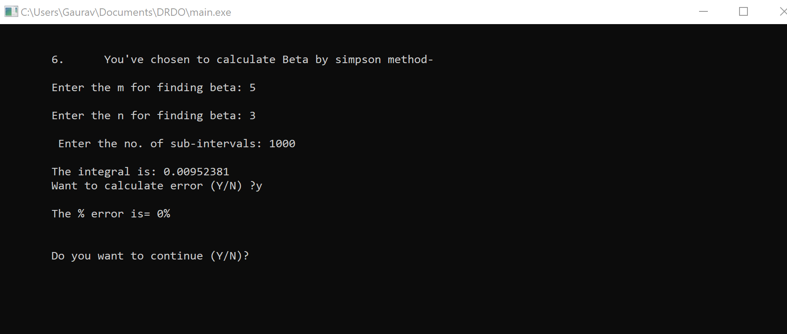
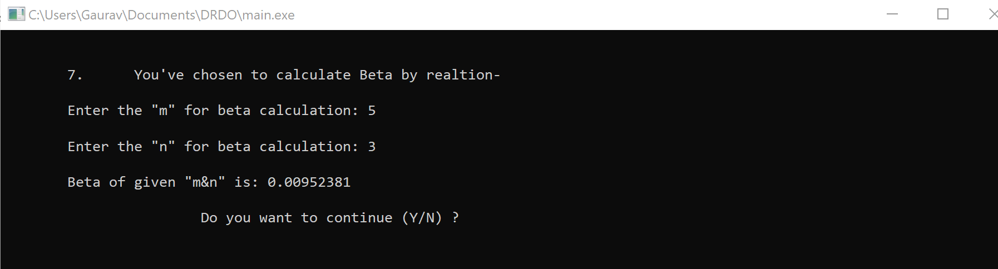
Gamma by Simpson method
Beta by simpson method
Beta by relation

Slide 10
References
[1] Applied Mathematics for Engineers and physicists by Pipes and Harvill
[2] “Numerical Methods” by S S. sastry.
[3] https://www.geeksforgeeks.org/rand-and-srand-in-ccpp/

Slide 11
Conclusion
Successful designing of required algorithms and methods for computation of functions.
Goals achieved-
1) Running time optimized for values of input upto 10 million.
2) Approximations improved for the factorial and error functions by stirlings method of factorial approximation.
3) Probability distribution curve for complementary and error functions satisfied and use to solve Maxwell- boltzmen constant for the velocities of particles in matter.

